Slide 1


Slide 2
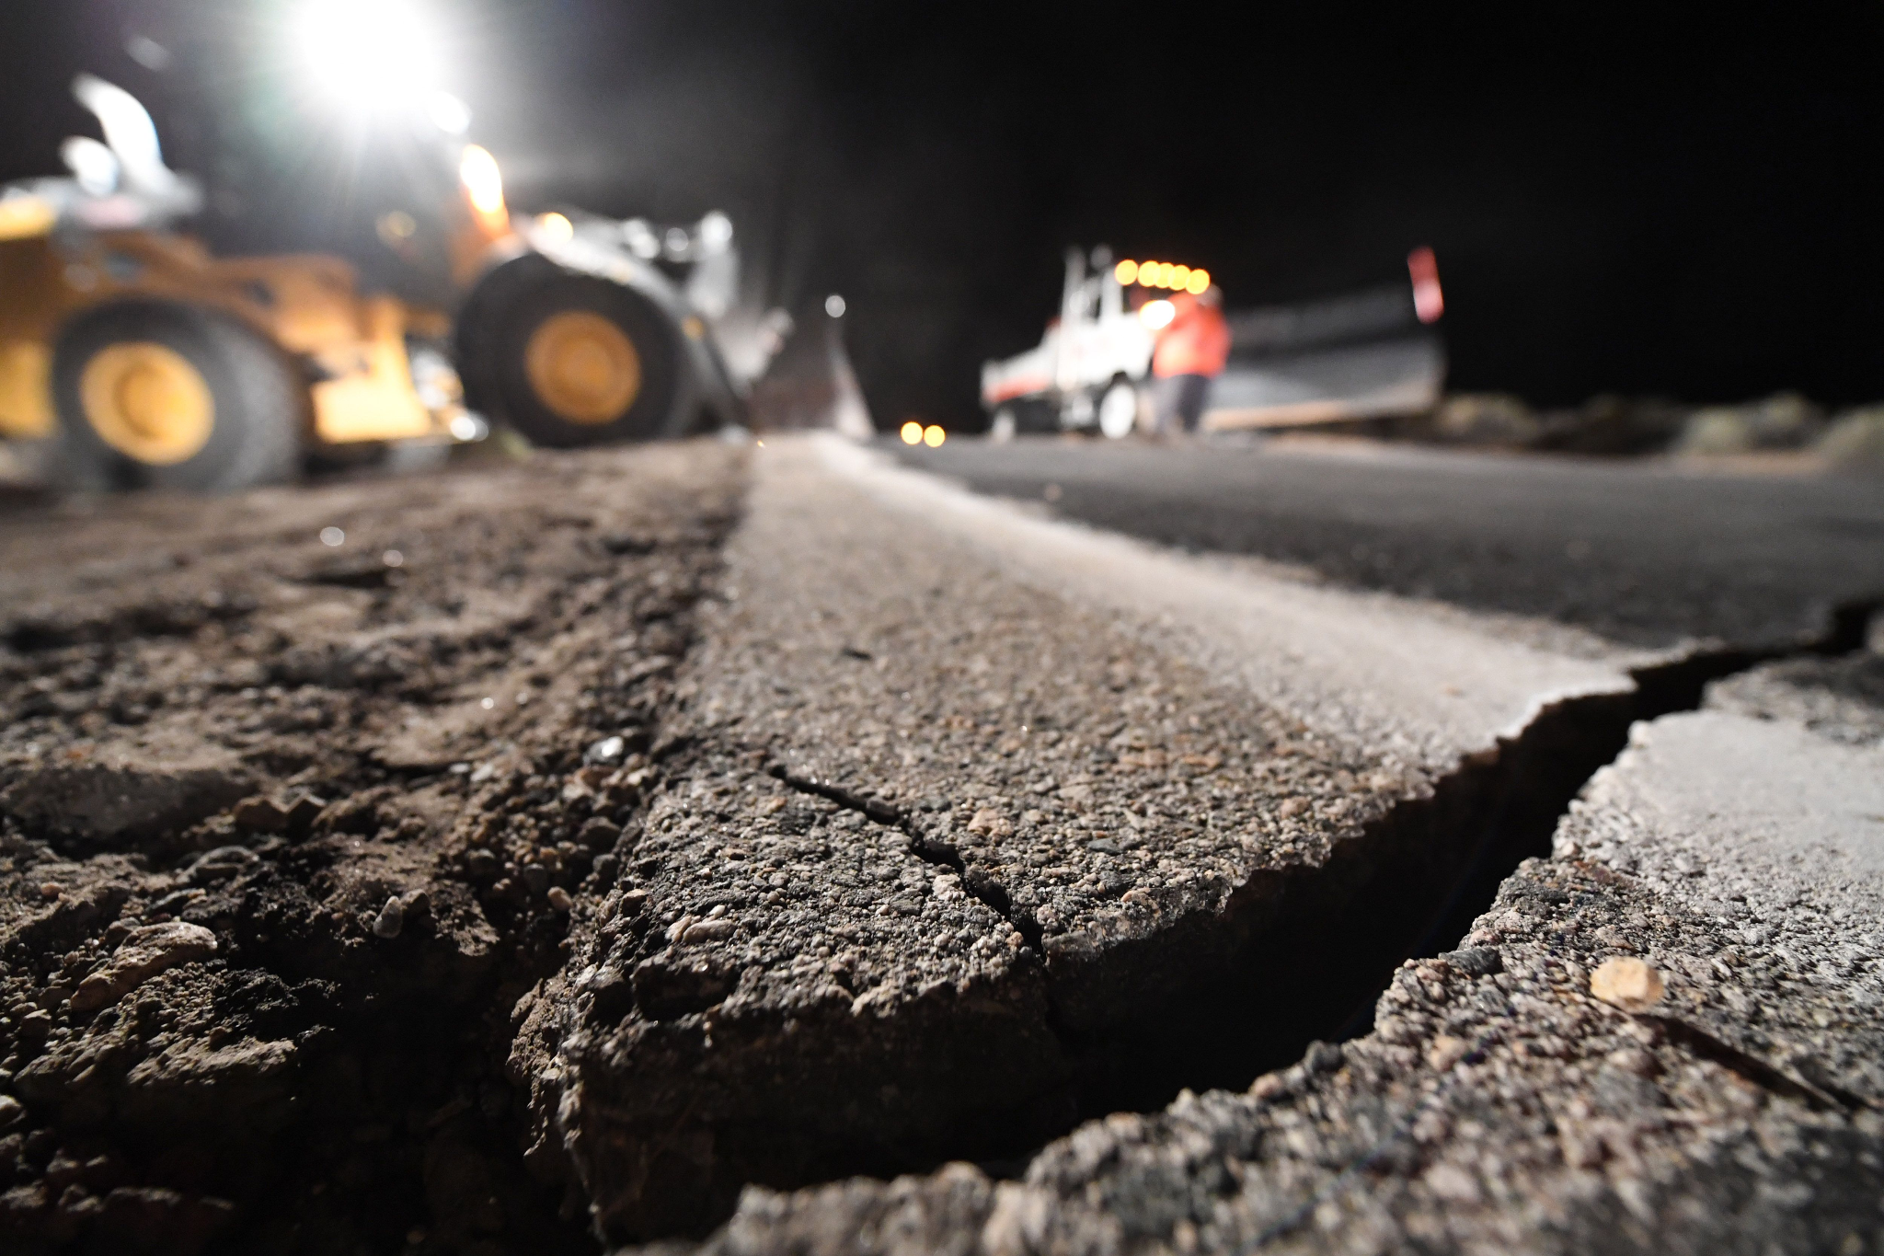
Project Objective:
The Objective of this project is:
1)Early Warning Systems
2)Real-time Monitoring
3)Location and Magnitude Prediction
4)Probabilistic Models
5)Risk Assessment

Slide 3
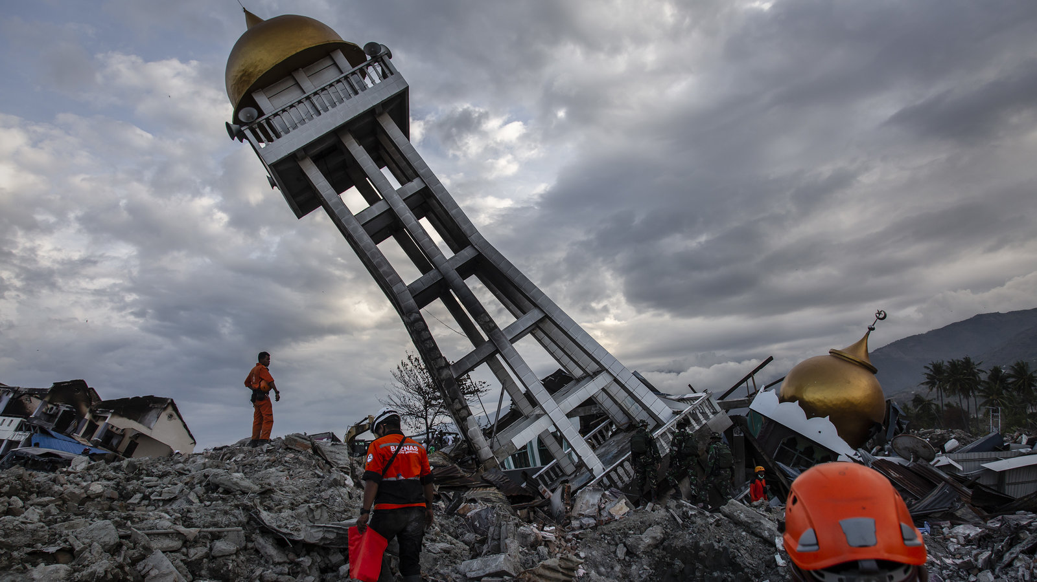
Project BackGround:
The background of this project:
1)Introduction to Earthquake
2)Historical Perspective
3)Data Sources
4)Current State of Earthquake Prediction
5)Challenges and Limitations

Slide 4
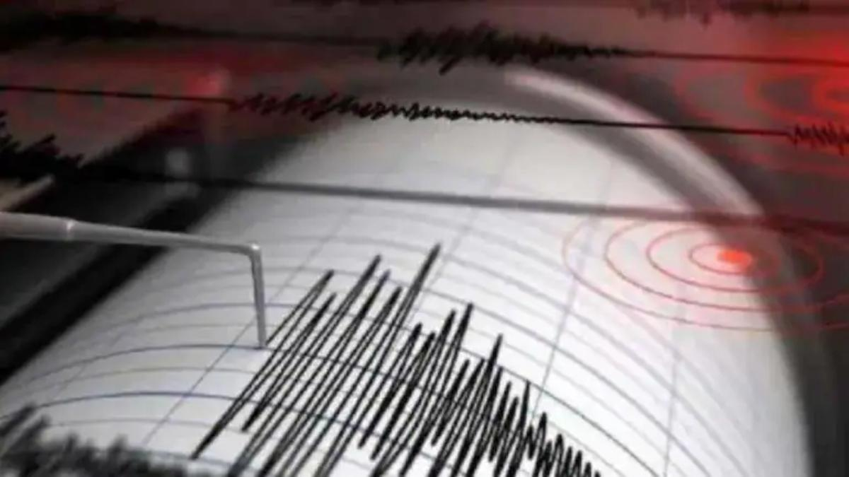
Features of the Project:
The features of the project are:
1)Data Collection
2)Data Preprocessing
3)Machine Learning Models
4)Deep Learning Models
5)Evaluation Metrics
6)Disaster Preparedness

Slide 5

Prerequisite of the Project:
The prerequisite of the project:
1)Domain Knowledge
2)Software Skills
3)Data preprocessing skills
4)Machine Learning Knowledge
5)Early Warning System Expertise

Slide 6

Benefits of this Project:
The various benefits that can be gained from this project are:
1)Early Warning
2)Risk Mitigation
3)Real Time Monitoring
4)Reduced Economic Impact
5)Community Engagement

Slide 7

Limitations of this Project:
There are various limitations of this project:
1)Data Quality
2)False Positives and Negatives
3)Resource Requirements
4)Data gaps
5)Community Acceptance
6)Long term and short term predictions

Slide 8

Future Enhancements of this Project:
There are still many ways in which the project can be improved.Some ways are:
1)Improved Data Source
2)More Advanced Machine Learning Models
3)Multi model Data Fusion
4)Sensor Technology
5)Regional Data Collection and Preprocessing

Slide 9

Presenters and the Mentor:
Presenters:
1)Azarudeen
2)Bharanidharan
3)Delli Ganesh
4)Divayanshu Tiwari
5)Viswanth Kumar
Mentor:
Mrs.Anjali Devi

Slide 10

Conclusion:
Even though there are many limitations at present times yet there are several ways in which they could be left behind moving on to the future.The future technology will be surely more advanced and will have all the required resources and the things which will surely increase the accuracy and provide a better outcome.
Thank You

